Slide 1
Exploratory Data analysis
Music Recommender system
By: Team-6

Slide 2
Table of contents
1.Introduction
2.Datasets
3.Merging the datasets.
4.Working on Duplicates.
5.Analyzing Process
Identifying unique attributes.
Identifying top 20 songs and plotting them.
Grouping data using User ID.
Grouping data using Song ID.
Grouping data using artist_name.
Grouping data using release(Title).
Exploring the popular artist and their songs.
6.Conclusion

Slide 3
Introduction:
We have been working on building a music recommender system based on the million song dataset.
The Million Song Dataset (MSD) , a collection of one million western popular music pieces, has enabled a large-scale research for many MIR applications.
This dataset is divided into several parts and put out in different files in order to work upon the particular data wisely.
The core of the dataset is the feature analysis and metadata for one million songs, provided by The Echo Nest. The dataset does not include any audio, only the derived features.

Slide 4
Datasets:
kaggle_songs.txt: This contains the song_id.
kaggle_users.txt:This contains the user_id.
kaggle_visible_evaluation_triplets:This contains the user_id,song_id and frequency.
taste_profile_song_to_tracks:This contains the song_id and the track_id.
unique_tracks:This contains the track_id,song_id,artist_name and release(Song Title) information.
But from this we will be using only the two datasets namely the triplet dataset and unique track dataset as it contains all the informations from other datasets.

Slide 5
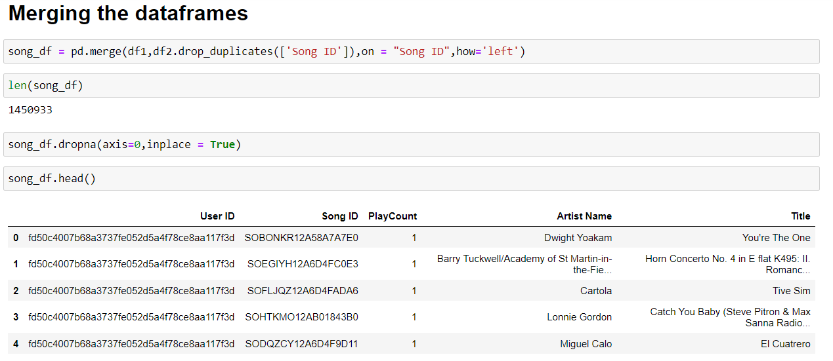
Merging of the Datasets:
We are merging the kaggle_visible_evaluation_triplets file and unique_track file into a single file using the merge function.
The triplet file has 140000 rows with 3 columns whereas the unique track file has 100000 rows with 4 columns.
The two files are merged on the attribute “Song ID” using the left method.
When these dataset are properly combined, we can provide more accurate information about respondents.

Slide 6
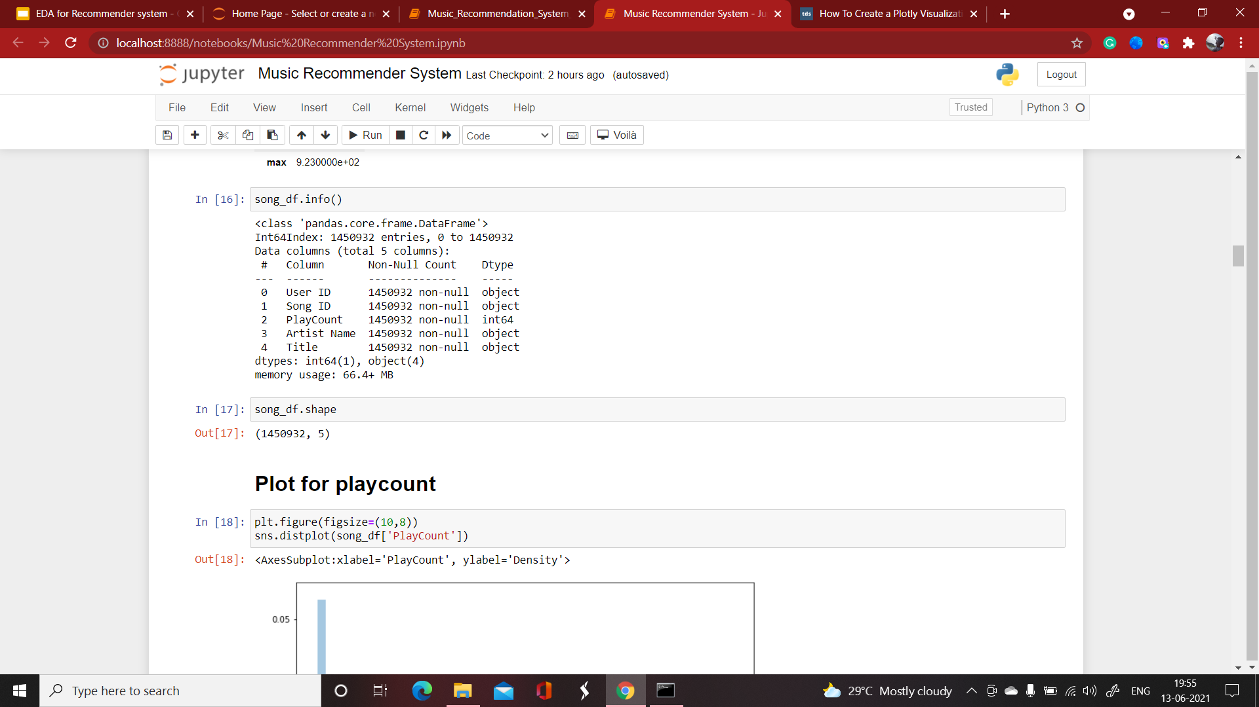
Working on duplicates:
Removing duplicate values in the dataset allows you to develop a strategic decisions on the accurate data.
In this the first occurrence value is kept and other identical values are deleted.
The merged dataset consist of many duplicate and null values.
Using the dropna and drop_duplicates function the null values and duplicate values are removed from the dataset.

Slide 7
Analyzing Process

Slide 8
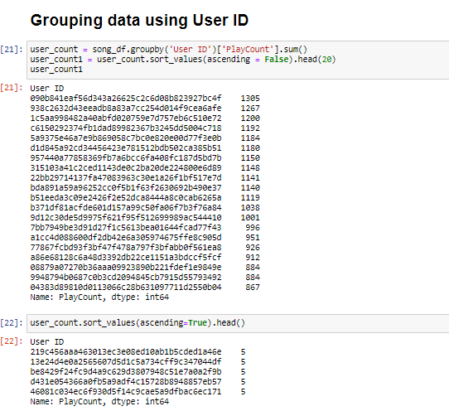
Grouping the data by user_id

Slide 9
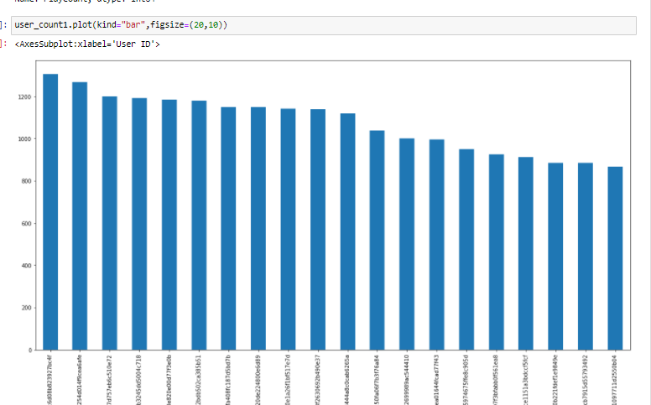
Grouping by user_id bar plot

Slide 10
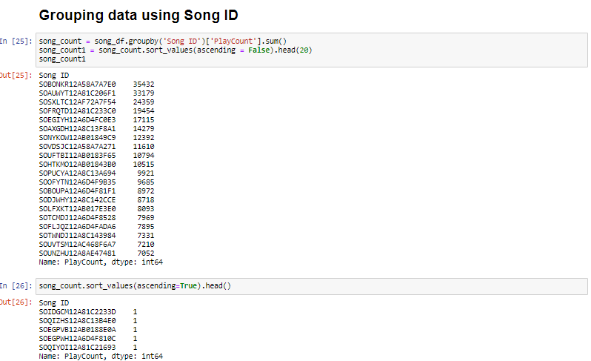
Grouping the data by song ID

Slide 11
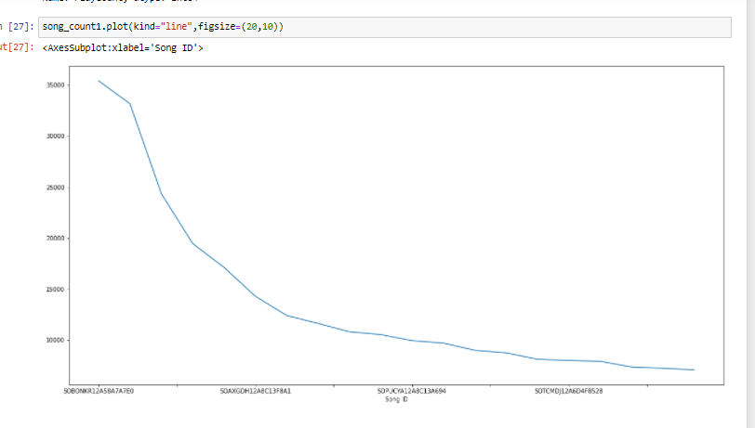
Grouping by song id line plot

Slide 12
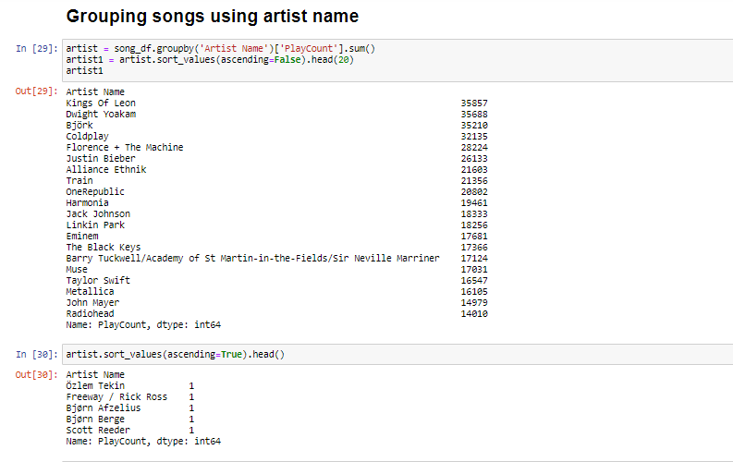
Grouping the data by artist name

Slide 13
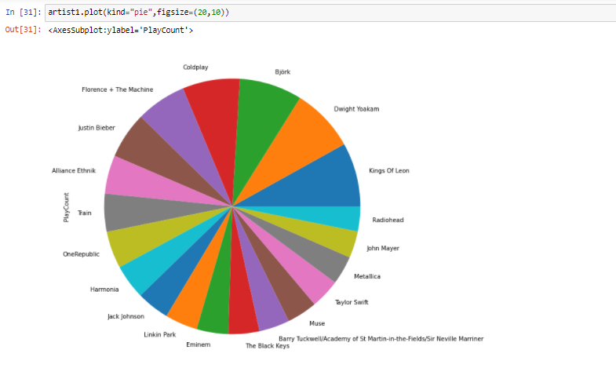
Grouping by artist name pie graph

Slide 14
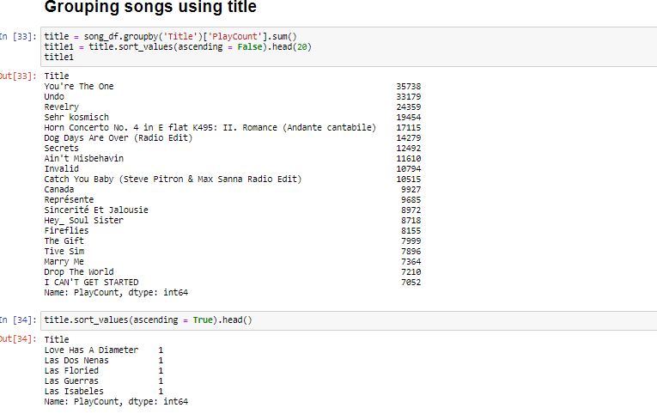
Grouping the data by title

Slide 15
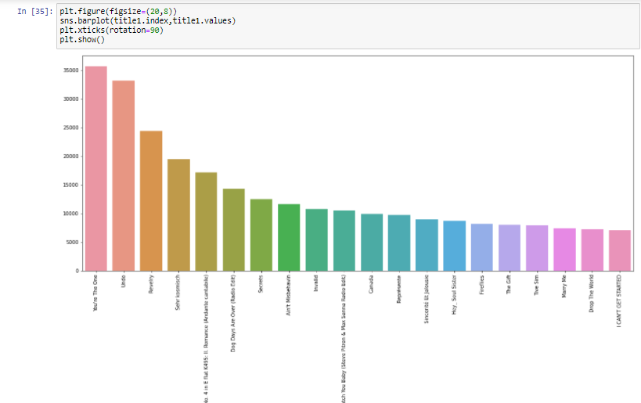
Grouping by title bar plot

Slide 16
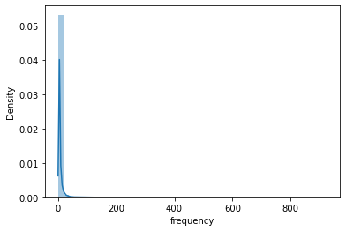
Pdf for frequency

Slide 17
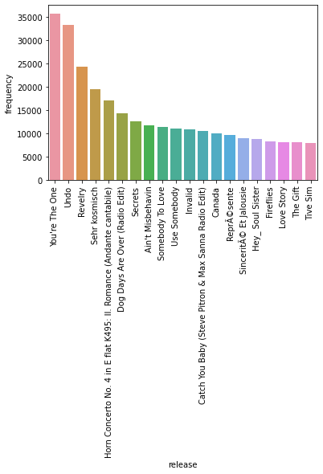
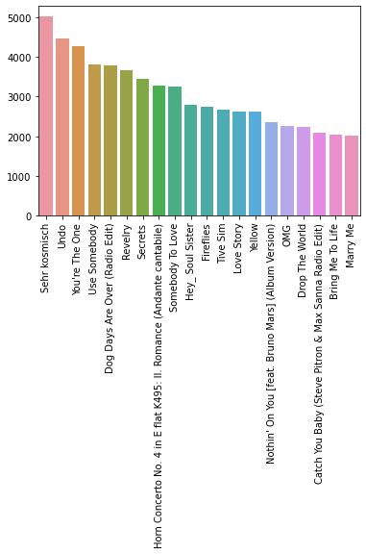
Top 20 songs : With Frequency v/s Without Frequency

Slide 18
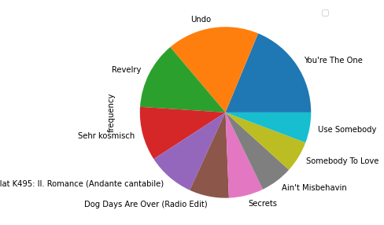
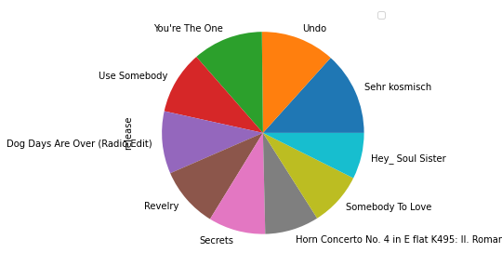
Top 10 songs : With Frequency v/s Without Frequency

Slide 19
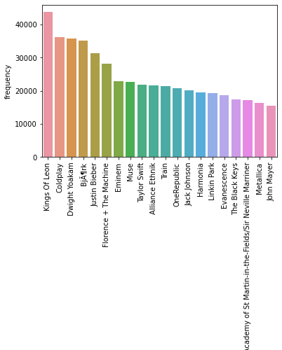
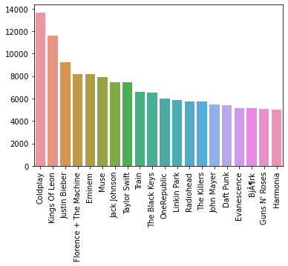
Top 20 artists : With Frequency v/s Without Frequency

Slide 20
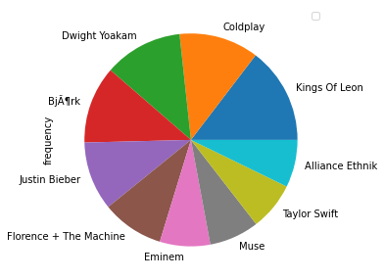
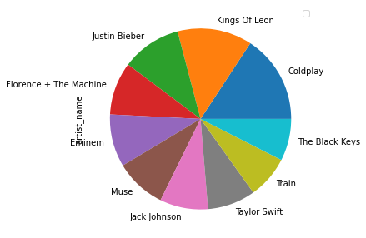
Top 10 artists : With Frequency v/s Without Frequency

Slide 21
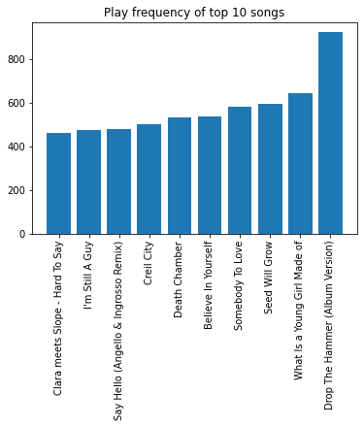
Songs with highest frequency by the top user

Slide 22
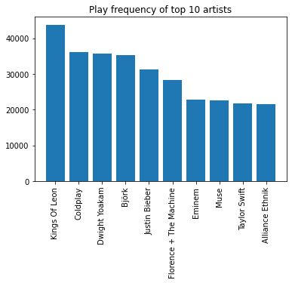
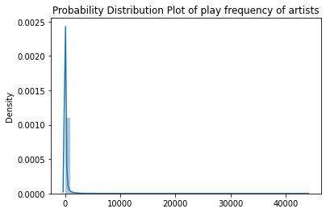
Play frequency of top 10 artists

Slide 23
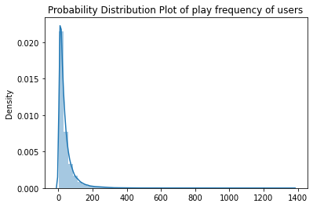
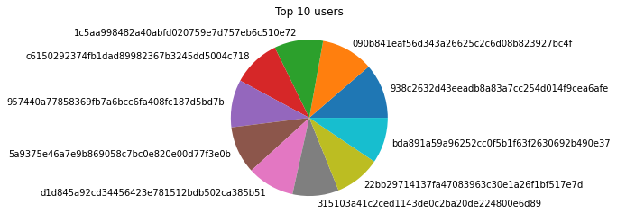
Top 10 users

Slide 24
Conclusion:
So far we have analyzed some fragments in the dataset.From this we come to know about various informations.
We merged the two dataframes to come up with all the informations in single dataframe.
The dataset has some duplicate values so we had removed those duplicates in order to work on the data reliably.
Then we moved onto the analyzing criteria.Where we worked on each columns of the dataset and also comparing few columns to get a insight on those fields.
We have used various plots in order to visualize the information that we got on doing some operations on the columns.
Next we will move to our EDA part where we will see the complete analysis with some code and graphs for clear understanding.

